Slide 1
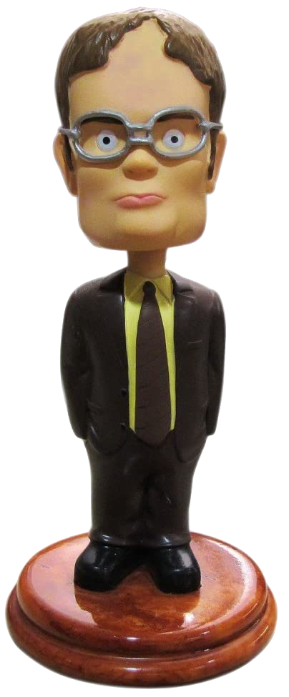
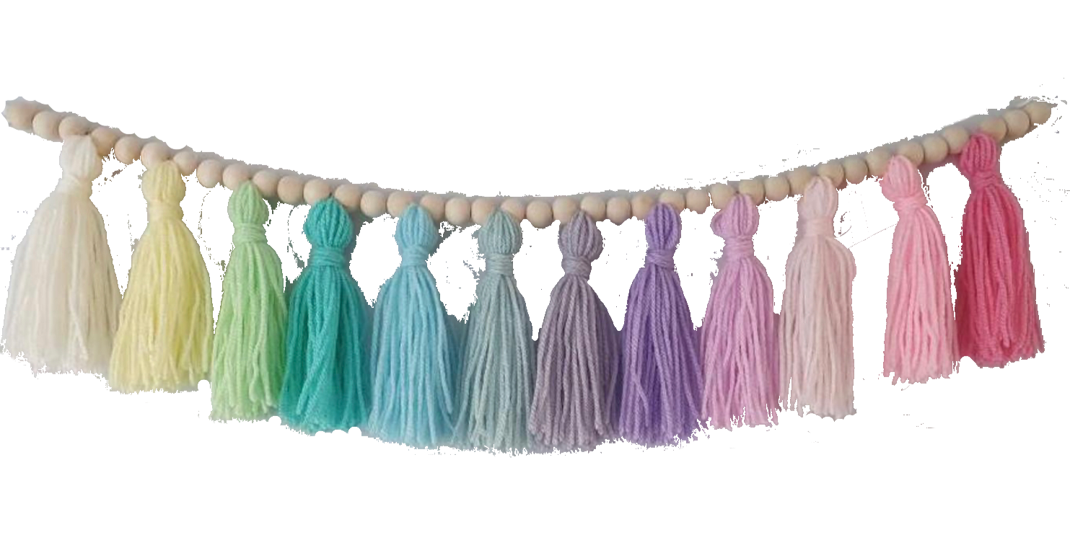
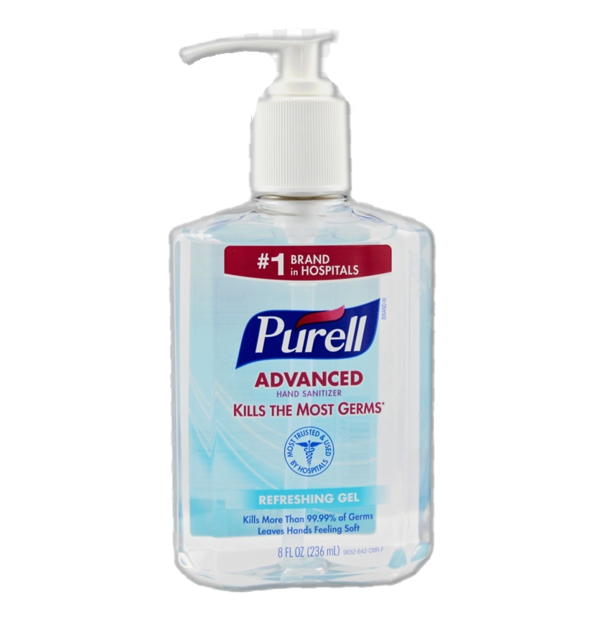
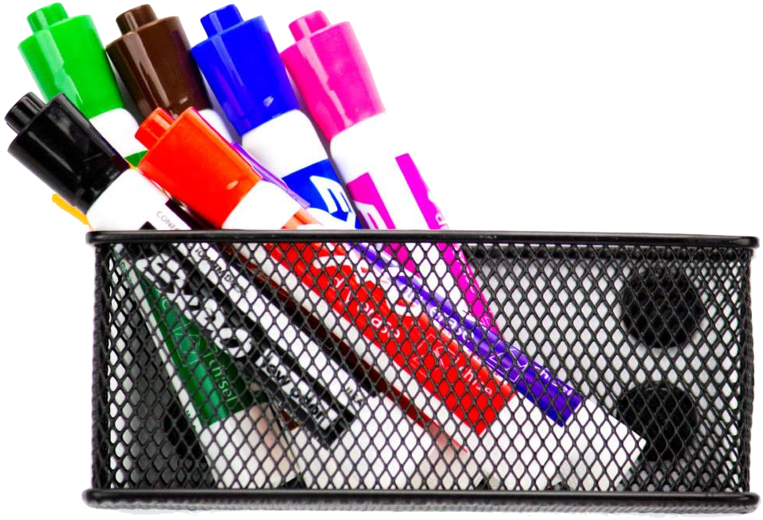
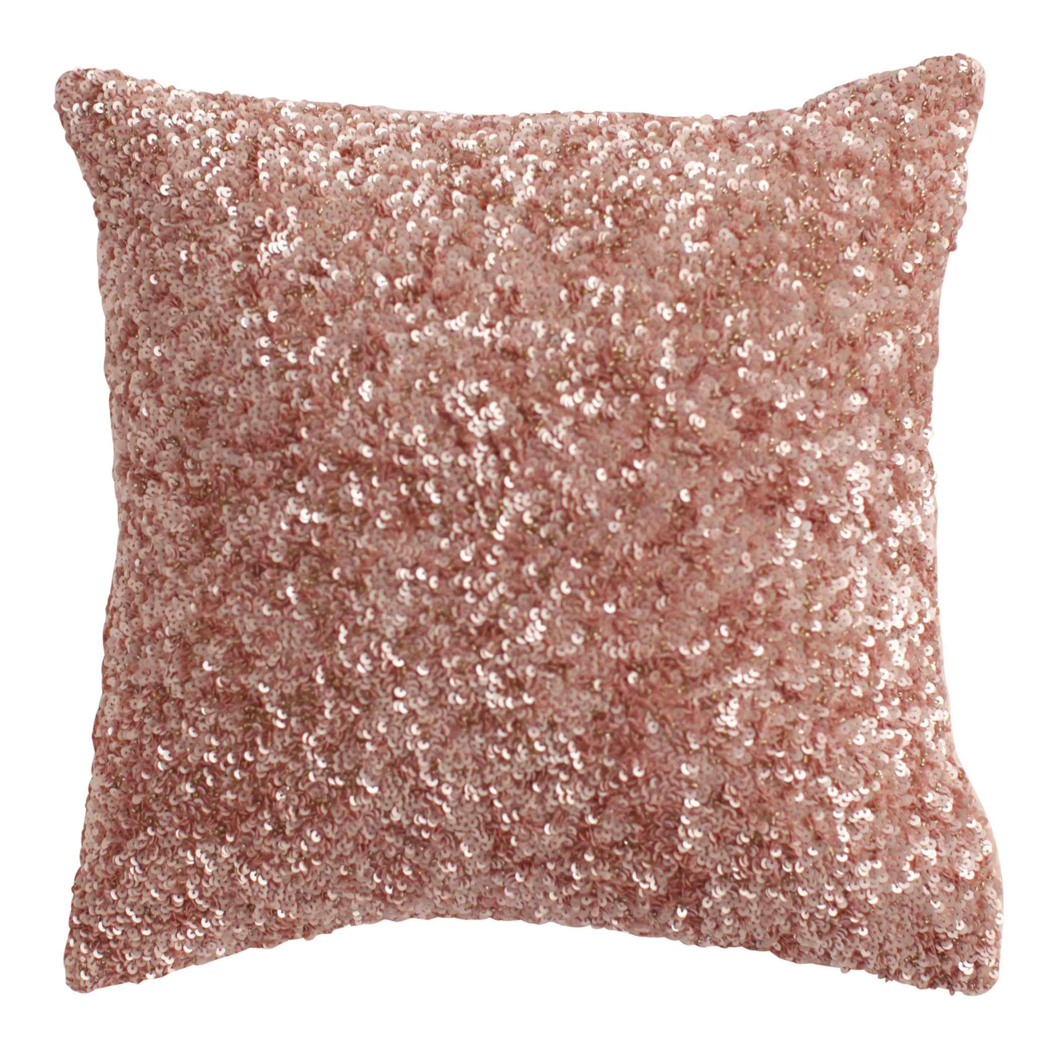
Welcome
To
Cartersville Virtual Academy
Second Grade
PebbleGo Login
Username: canes
Password: teach
Schoology/eSpark Login
Username: Lunch Number
Password: Birthdate (mmddyyyy)
Raz-Kids: DSCOTT88
Mrs. Scott
Class Resources
(Click me to see where I go!)
dscott@cartersvilleschools.org

